Slide 1
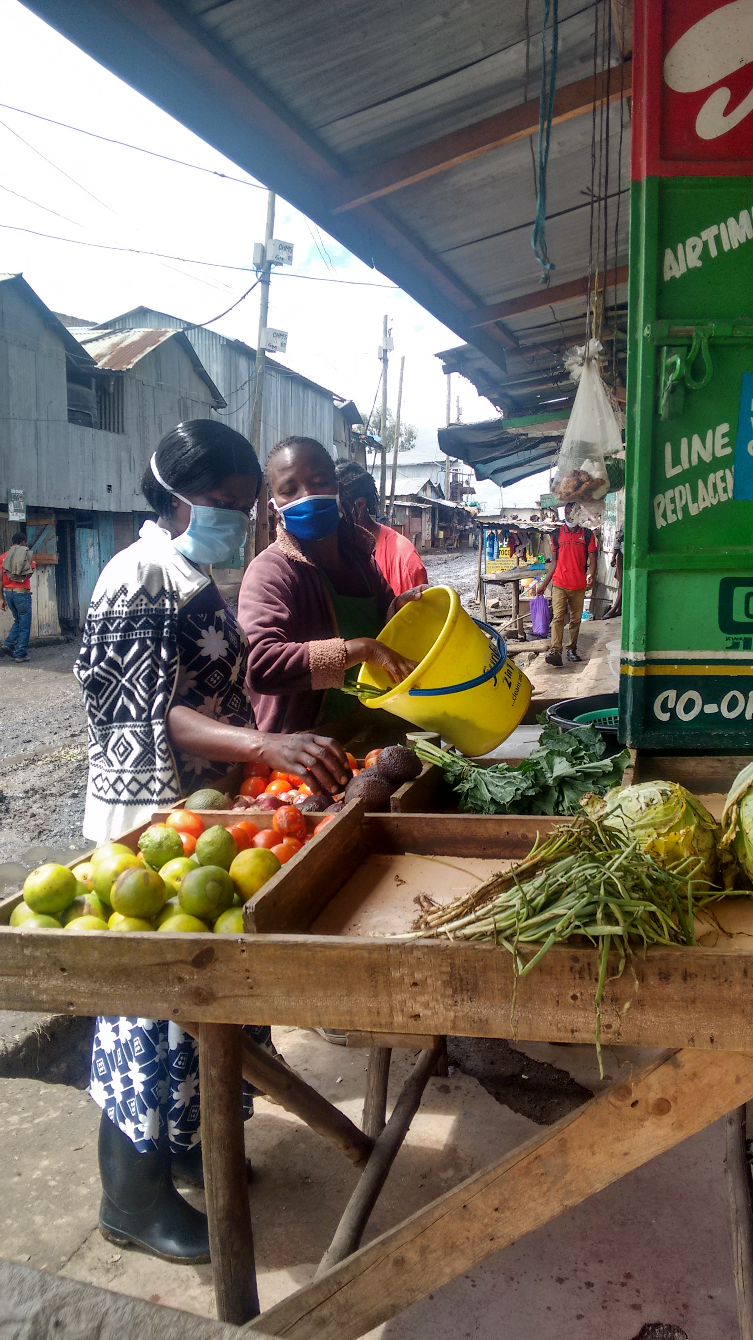

Capture cards
Concepta, a 37-year-old informal trader (blue face mask)
attending to her client at her grocery store in Mukuru.

Slide 2
Capture card
The same scenario is likely to play out if Concepta’s children do not further their education and ultimately land stable jobs.
Quote
Insight
“My first born daughter cleared secondary school two years ago and is currently looking for work. She has studied short courses such as dressmaking, modelling. It’s just that there are no jobs.”
.
When
29 April 2020
Where
Mukuru kwa Njenga
Sisal zone
Who
Concepta
Reported by:
Victor

Slide 3
Capture card
With no medical insurance, a shock like this (medical operation) exhausts the family meagre savings. Concepta was forced to prioritize payment of the medical bills over higher education for her daughter.
Quote
Insight
“When my husband got sick (arthritis), we could not afford to take our daughter to a tertiary institution after clearing her secondary education. My husband is still recovering. He was supposed to be operated on both legs (hip joints) but this cannot be done at once. He has to wait for another year to have the second operation. Since my husband is still recuperating and cannot work, it is my business that is taking care of our household’s basic needs.”
When
29 April 2020
Where
Mukuru kwa Njenga
Sisal zone
Who
Concepta
Reported by:
Victor

Slide 4
Capture card
Illness and lack of a stable job means Concepta’s family depends solely on her business for survival.
Quote
Insight
“Prior to the illness, my husband used to sell polythene papers. The ban on polythene by the Government forced him to look for odd jobs.”
When
29 April 2020
Where
Mukuru kwa Njenga
Sisal zone
Who
Concepta
Reported by:
Victor

Slide 5
Capture card
Perceived safety ensured Concepta’s business thrived before the pandemic – location of the business matters for its success. The reduced operating hours have also impacted her business negatively.
Quotes
Insights
“I used to keep my business open until 9:30pm to serve people who come home late from work. Since I don’t live far from here and my business is near the police post I could close late. The curfew occasioned by the coronavirus has affected my business. I have to close by 7pm. Also, I have been forced to reduce my stocks “mboga nilipunguza kuleta”. I used to buy vegetables worth 300 now I buy stock worth either 100 or 150 to ensure that it’s cleared but sometimes even this reduced stock spills over to the next day because of the reduced business operating hours.”
When
29 April 2020
Where
Mukuru kwa Njenga
Sisal zone
Who
Concepta
Reported by:
Victor

Slide 6
Capture card
“Concepta was forced to reduce her stocks by almost half due to the challenges brought about by the pandemic.”
Quote
Insight
“Previously, I could buy lunch and dinner and save 100 from the profits I made in a day. This is separate from the 1500 which was meant to buy produce. But currently I end up making sales worth 800 or 900. When you deduct expenses like milk, transport, I end up going to the market with either 600 or 700.”
When
29 April 2020
Where
Mukuru kwa Njenga
Sisal zone
Who
Concepta
Reported by:
Victor

Slide 7
Capture card
Concepta’s strategy of mitigating total food wastage as a result of the slowdown in business.
Quote
Insight
“If the stock spills over, I position it at the back and the fresh ones at the front. This means that I have to go for fresh produce everyday so that when a client comes in, I offer her one from the previous day mixed with the fresh produce.”
When
29 April 2020
Where
Mukuru kwa Njenga
Sisal zone
Who
Concepta
Reported by:
Victor

Slide 8
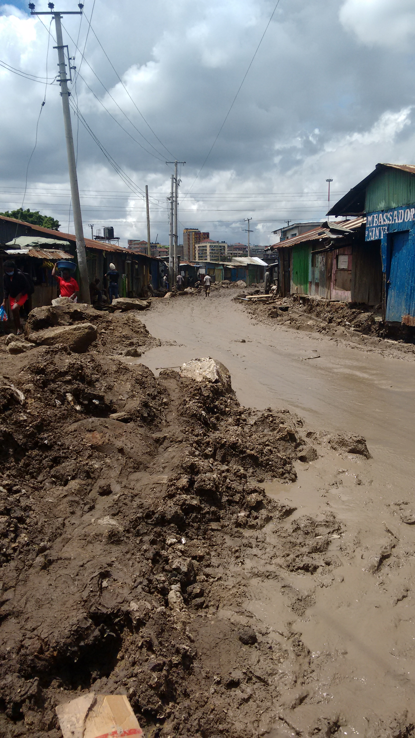
Capture card
Most businesses along this road under construction have closed owing to their inaccessibility.
Observation
Insight
When
29 April 2020
Where
Mukuru kwa Njenga
Sisal zone
What
Feeder road
Reported by:
Victor

Slide 9
Capture card
With no convenient place to dump the waste, Concepta is forced to give it out for free. It is also costly to get someone to who can go dump the waste for you.
Quote
Insight
“In the likely scenario the produce turns to waste, I give it out to a guy who rears pigs for free. I don’t charge them because it seems like they are used to getting the waste for free. Otherwise, you have to look for a place far from here to go dump the waste. During the dry season, vegetables don’t go bad quickly so this could be the time to sell waste.”
When
29 April 2020
Where
Mukuru kwa Njenga
Sisal zone
Who
Concepta
Reported by:
Victor

Slide 10
Capture card
Possibilities for generating income through waste.
Quote
Insight
“In my opinion, I think the waste can generate money, there is nothing that cannot generate money. An example is the people who collect waste from our plots, they charge us 20 shillings every Sunday and that’s money. When these people got used to collect the waste for free, the habit stuck. I have observed that sometimes when I have so much waste from vegetables that have overstayed, the guy who collects the waste sympathizes with me and offers me little money like 10 shillings. I think we can come to an understanding with the person who rears pigs or cattle to pay a certain amount of money for a certain amount of waste.”
When
29 April 2020
Where
Mukuru kwa Njenga
Sisal zone
Who
Concepta
Reported by:
Victor

Slide 11
Capture card
Reduced returns means Concepta can only buy what she can afford. This is usually what she can carry on her own. This also means loss of livelihood for loaders.
Quote
Insight
“Nowadays I don’t have to hire a loader (mkokoteni) to ferry my produce from the market to the matatu stage. Previously I could get someone and pay them Kshs. 50 to carry my luggage to the stage and Kshs. 100 from the stage in Mukuru to my kiosk.”
When
29 April 2020
Where
Mukuru kwa Njenga
Sisal zone
Who
Concepta
Reported by:
Victor

Slide 12
Capture card
The are other stakeholders who work in Mukuru but are not residents of Mukuru who prefer to buy from Concepta because of the affordable prices compared to where they live.
Quote
Insight
“Most of my clients are from Mukuru. I also have clients from the nearby hospital (MMM), the doctors who prefer the indigenous vegetables. I also had teachers place orders before the schools were shut down due to the pandemic.”
When
29 April 2020
Where
Mukuru kwa Njenga
Sisal zone
Who
Concepta
Reported by:
Victor

Slide 13
Capture card
Hospitals, schools provide an additional client base for traders like Concepta.
Quote
Insight
“Most of my clients are from Mukuru, who ask me to chop kales worth 10, tomatoes at 5 and sometimes they send their children. The proposed platform could better serve big establishments like hospitals, schools who place orders in bulk, such as fruits. I get orders to take kales to a school twice a week. So I chop it and take it to them.”
When
29 April 2020
Where
Mukuru kwa Njenga
Sisal zone
Who
Concepta
Reported by:
Victor

Slide 14
Capture card
Having in mind the target clients or their various needs could inform how to tailor the platform to suit these needs.
Quote
Insight
“It will be difficult to get the platform to serve Mukuru residents. People here are used to fetching their produce for themselves in small quantities. Even during this curfew, some come and ask me to chop kales worth 10 so I do that while inside my store with them.”
When
29 April 2020
Where
Mukuru kwa Njenga
Sisal zone
Who
Concepta
Reported by:
Victor

Slide 15
Capture card
Additional effort needs to go towards marketing the platform.
Quote
Insight
“I would be very happy to get additional clients who can buy produce at good prices but where and how will I get these other clients? The platform sounds like a good idea because one you have reduced my workload, secondly you have given me additional clients. With the platform, I am likely to increase my stock and expand my business. We can try test to see if it works.”
When
29 April 2020
Where
Mukuru kwa Njenga
Sisal zone
Who
Concepta
Reported by:
Victor

Slide 16
Capture card
How does the platform take care of small orders? Can the platform aggregate the orders per region, specific days? What quantities can bodabodas deliver at a go to ensure value for money for every delivery?
Quote
Insight
“When one offers to take your produce in large quantities to sell it on your behalf, that reduces my workload. I believe the client who orders through the platform will not order tomatoes worth 10, kales worth 5, he or she will order in large quantities.”
When
29 April 2020
Where
Mukuru kwa Njenga
Sisal zone
Who
Concepta
Reported by:
Victor

Slide 17
Capture card
Chamas present an opportunity for traders like Concepta to grow their businesses and achieve their long-term ambitions.
Quote
Insight
“I don’t save in a bank but in a merry-go-round with other women. We give out money every day for the merry-go-round. Everyday we give out 200 and we are 50 members. This is a good amount of money for business people in the informal settlement. If I keep the money in the house, I am likely to spend it so it’s better off in the merry-go-round. When it’s my turn to receive the money, I deposit it in my M-Pesa account. Once there it serves many purposes for instance I have started a construction project in the countryside in Kisii and I have bought bags of cement. I am hoping my business thrives so that I can finish constructing my house. I have not lost hope.”
When
29 April 2020
Where
Mukuru kwa Njenga
Sisal zone
Who
Concepta
Reported by:
Victor

Slide 18
Capture card
Safaricom’s mobile based loans come in handy for the ‘unbanked’ like Concepta.
Quote
Insight
“I have an account on M-Shwari so I get loans from M-Shwari and pay back. As a businessperson, you can’t survive without a place you can borrow a loan. You need a place where you can borrow money for an emergency and so M-Shwari has helped me on that front. I only borrow loans from M-Shwari. Currently I don’t have any loan since I borrow and repay promptly.”
When
29 April 2020
Where
Mukuru kwa Njenga
Sisal zone
Who
Concepta
Reported by:
Victor

Slide 19
Capture card
Affirmative action funds meant for women entrepreneurs offer low interest loans and are worth pursuing if the challenge of borrowing loans in a group(a requirement) is addressed.
Quote
Insight
“You need to be in a group to benefit from the Government loans. To be honest, many women have suffered as a result of these loans. There are women who disappear once the loans have been issued. It could be due to dwindling business fortunes which forces one to close a business. For instance, coronavirus has led to some businesses closing and people moving upcountry. This forces the rest to pay an additional amount to cover for those who went. This discouraged me from taking the loans.”
When
28 April 2020
Where
Mukuru kwa Njenga
Sisal zone
Who
Concepta
Reported by:
Victor

Slide 20
Capture card
Concepta’s business plays a key role in meeting the household’s basic needs.
Quote
Insight
“The best thing this business has done for me is that it has enabled me to educate my daughter. When you get the merry go round you pay school fees. Even for my son since the dad got sick, I have been paying school fees. We can’t go hungry, I pay rent.”
When
29 April 2020
Where
Mukuru kwa Njenga
Sisal zone
Who
Concepta
Reported by:
Victor

Slide 21
Capture card
Male champions like Concepta’s husband contribute a great deal in the success of the business.
Quote
Insight
“Before my husband got sick, he was very supportive. He was the one who encouraged and supported me to start this business when he was still working.”
When
29 April 2020
Where
Mukuru kwa Njenga
Sisal zone
Who
Concepta
Reported by:
Victor

Slide 22
Capture card
Worth investing into the experience of traders like Concepta who value self-employment.
Quote
Insight
“People like me have the urge to do business but we lack the means to expand our business. I don’t want to be employed. I am used to running my own business. I have never been employed since I came to Nairobi.”
When
29 April 2020
Where
Mukuru kwa Njenga
Sisal zone
Who
Concepta
Reported by:
Victor

